Slide 1
Component of Artificial NN

Slide 2
Introduction
Artificial Neural Networks (ANN)
Information processing paradigm inspired by biological nervous systems
ANN is composed of a system of neurons connected by synapses
ANN learn by example
Adjust weight connections between neurons

Slide 3
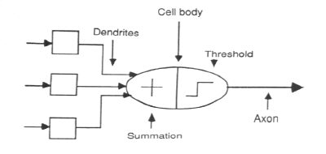
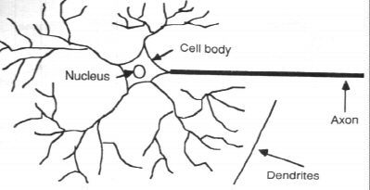
Neuron Model
Natural neurons Abstract neuron

Slide 4
Neuron Model
Abstract neuron model:

Slide 5
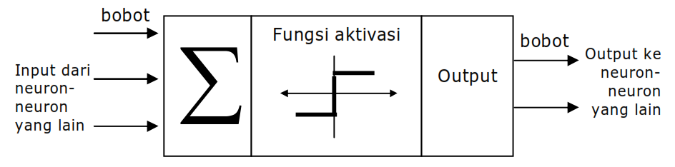
Neuron model
Elements:
Input (features of object)
Weight (the values between connection)
Sum (summing the input time weight)
Activation function (to active the summation output according to given threshold)
Output (the target)

Slide 6
Input
The successful of ANN mostly depend on data input.
The data input must be a features of an object (except for CNN)
Must have as much small size as possible

Slide 7
Weight
Values between neurons connection which represented by vector or matrix
Firstly, initialized by zeros or random numbers
The initialized weights are adjusted by training (learning)

Slide 8
Sum
Sum is employed by neuron to summation the calculation of the weight*input
X₁=1
w₁= 0.5
∑
ƒ
y
x₂=0
w₂ = 0.3
Sum=y_{in} = x₁w₁ + x₂w₂
y_{in} = 1x0.5 + 0x0.3 = 0.5

Slide 9
Output (y)
X₁=1
w₁= 0.5
∑
ƒ
y
x₂=0
w₂ = 0.3
Activation Function:
Binary Step Function
θ = 0.5,
ƒ(y-in) = 1 if y-in >= θ dan ƒ(y-in) = 0
Sum=y_{in} = x₁w₁ + x₂w₂
y_{in} = 1x0.5 + 0x0.3 = 0.5
y=ƒ(y-in) = ƒ(0.5)
= 1

Slide 10
Exercise : determine the y of cases below:
2 input AND
2 input OR
x₁ | x₂ | target
1 | 1 | 1
1 | 0 | 0
0 | 1 | 0
0 | 0 | 0
x₁ | x₂ | target
1 | 1 | 1
1 | 0 | 1
0 | 1 | 1
0 | 0 | 0

Slide 11
Exercise : determine the y of cases below:

Slide 12
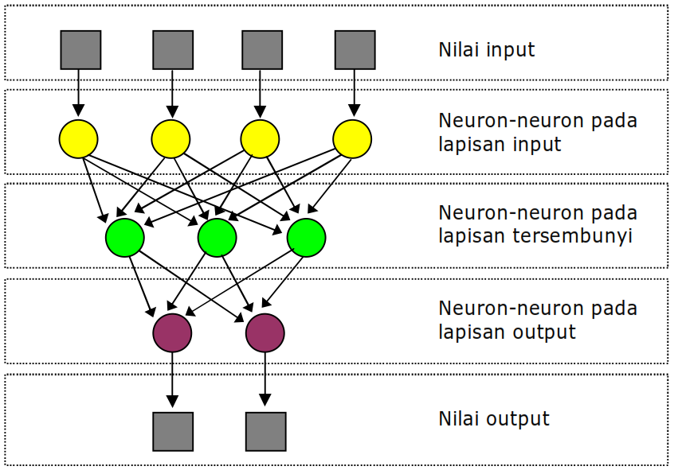
Architecture of ANN
Neuron (node) is small part of ANN
A collection neurons in the same level forms a layer

Slide 13
Architecture of ANN
Component of ANN:
Set of input
Neuron layer:
Input layer
Hidden layer
Ouput layer
Output set (target)
Note:
The values of connection between layer called as weight vector,
Usually each layer of ANN is added a Bias Node that has constant weight

Slide 14
Architecture of ANN
Three type architecture of ANN
Single layer NN
Multi layer NN
Competitive layer NN

Slide 15
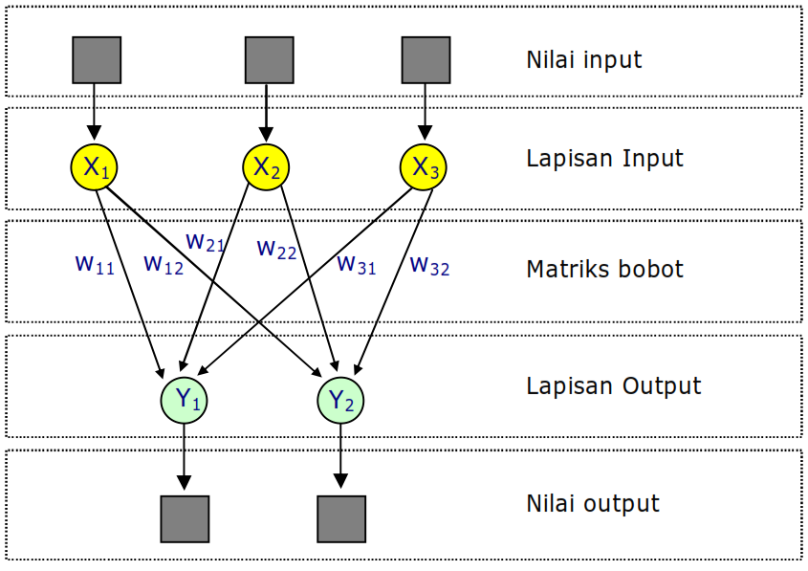
Single Layer Net
Single Layer Network has 1 active layers
Perceptron ADALINE, AM, Hopfield, LVQ, SOFM

Slide 16
Example Simple NN
where f(a) is the
step function, such
that: f(a)=1, a > 0
f(a)=0, a <= 0
“Full Meal Deal”
x1
x2
y
w0=
0 0 0
0 1 1
1 0 1
1 1 1
w1
w2
x0=1
x1
x2
Fries
Burger
H = {W|W ∈ R^{(n+1)}}
Source: CogNova Tech.

Slide 17
Example
Simple
Neural Network
1,0
1,1
Logical OR
Function
x₁ x₂ y
0 0 0
0 1 1
0 1
1 1 1
y = f(w₀+w₁x₁+w₂x₂)
x₂
0,0
0,1
x₁
What is an artificial neuron doing when it learns?
Able to solve only linear discriminate functions
Source: CogNova Tech.

Slide 18
Limitations of Simple NN
The Limitations of Perceptrons (Minsky and Papert, 1969)
Able to solve only linear discriminate functions; i.e. classes which can be divided by a line or hyper-plane
However, most functions are more complex (non-linear or not linearly separable)
This crippled research in neural net theory for 15 years ....
Source: CogNova Tech.
Notes:
Show pattern space OH for “take-out special” vs. “Dinner for two”.
Also OHs for XOR and linear dependent points.

Slide 19
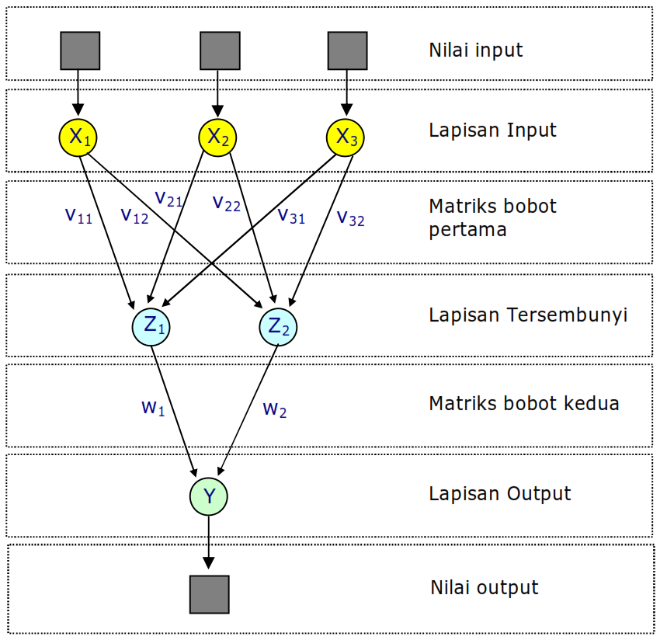
Multi Layer NN
Exp.
3 Layer Network has
2 active layers
Type of ML Net: MLFF with BP, MADALINE, Neocognitron, RBF

Slide 20
Example ML NN
Multi-layer
Neural Network
Hidden layer
of neurons
1,0
1,1
Logical XOR
Function
x1 x2 y
0 0 0
0 1 1
0 1
1 1 0
x₂
0,0
0,1
x₁
Two neurons layer are need! Their combined results
can produce good classification.

Slide 21
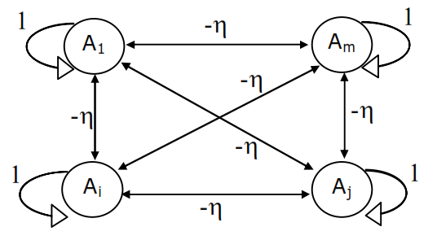
Competitive layer NN
The weight in η
Type of ML Net: ART, BAM, BSB, Boltzman Machine, Cauchy Machine, Hopfield, RNN

Slide 22
Example Recurrent NN
Input
Outputs
Hidden nodes
See the tutorial of RNN: http://www.wildml.com/2015/09/recurrent-neural-networks-tutorial-part-1-introduction-to-rnns/

Slide 23
Activation Function
One important factor of neuron behavior besides the input pattern
The neurons in the same layer must have the same activation function
Types activation function: Hard Limit, Linear, Sigmoid, etc

Slide 24
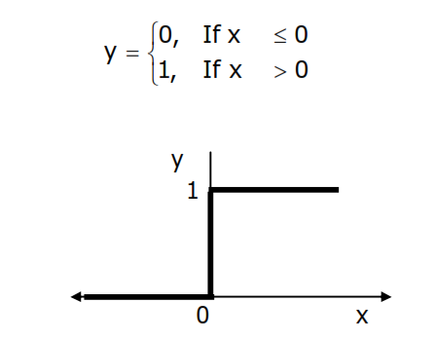
Binary Step Function (Hard Limit)
To convert continuous input variable into binary output (0 or 1)

Slide 25
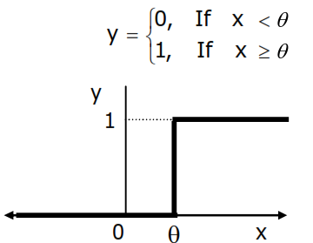
Binary Step Function (Threshold)
To convert continuous input variable into binary output (0 or 1) based on given threshold θ

Slide 26
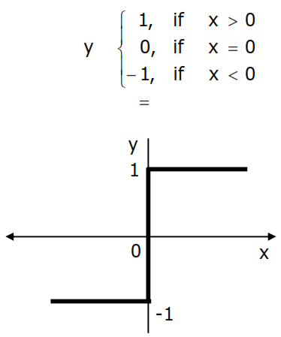
Bipolar Function (Symmetric hard Limit)
Similar to hard limit function, but the output (-1, 0, or 1) :

Slide 27
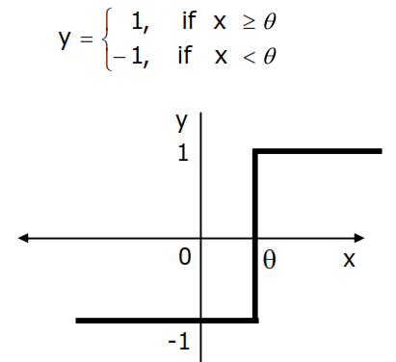
Bipolar Function (Threshold)
Similar to symmetric hard limit function, but the output (-1, 0, or 1) based on based on given threshold θ:

Slide 28
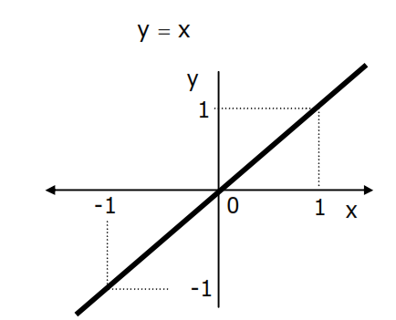
Linear Function (Identity)
The output is the same as the input :

Slide 29
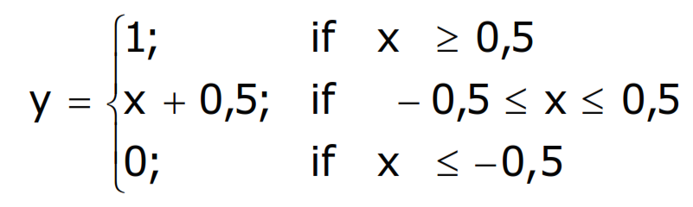
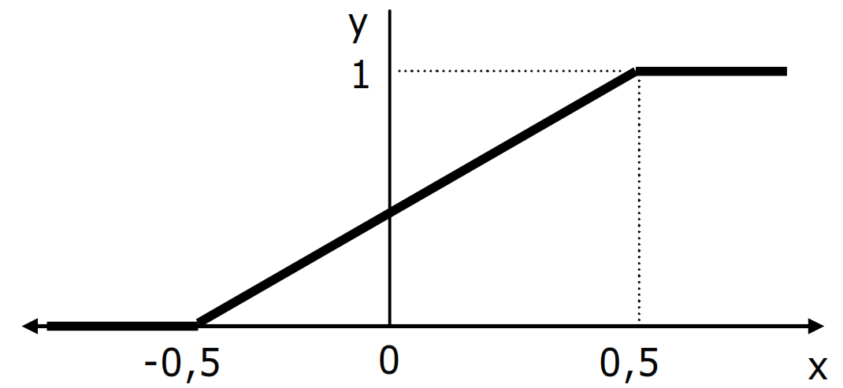
Saturating Linear Function
The output is formulated:

Slide 30
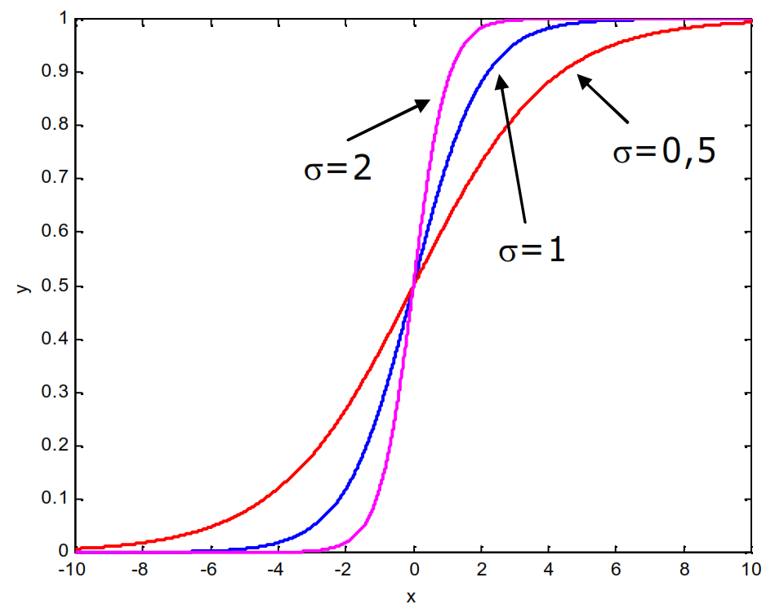
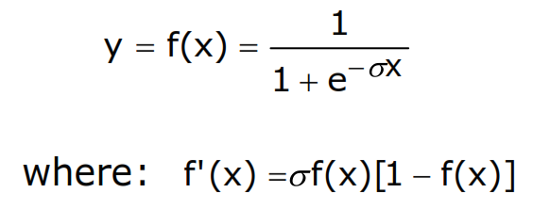
Binary Sigmoid Function
Usually for BP training NN
Implemented when the NN output is in the range 0~1
The formula:

Slide 31
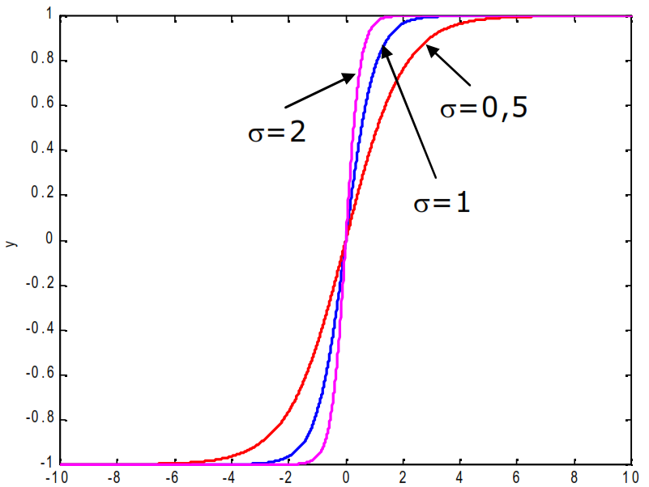
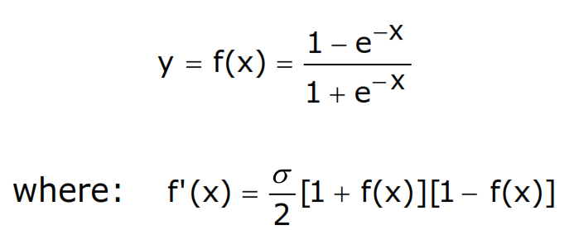
Bipolar Sigmoid Function
Similar to binary sigmoid, but the output is in the range -1~1
The formula:

Slide 32
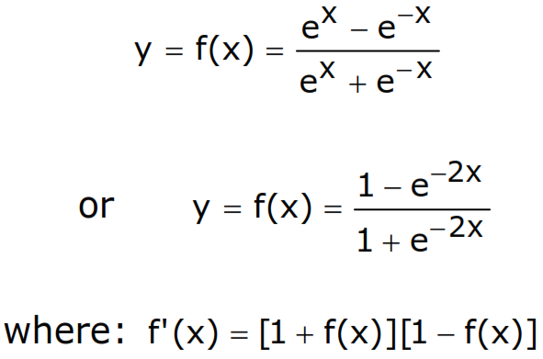
Hyperbolic Tangent Function
Similar to bipolar sigmoid, which the output is in the range -1~1
The formula:

Slide 33
Exercise Determine the y of case below using AF:
x₁ | x₂ | target
1 | 1 | 1
1 | -1 | -1
-1 | 1 | -1
-1 | -1 | -1
X₁=1
w₁= 0.5
∑
ƒ
y
x₂=0
w₂ = 0.3
Bipolar Sigmoid Function
Hyperbolic Tangent Function

